Slide 1

Modern Database Management
Thirteenth Edition
Chapter 7
Databases in Applications
Copyright © 2019, 2016, 2013 Pearson Education, Inc. All Rights Reserved
Notes:
If this PowerPoint presentation contains mathematical equations, you may need to check that your computer has the following installed:
1) MathType Plugin
2) Math Player (free versions available)
3) NVDA Reader (free versions available)

Slide 2
Learning Objectives
7.1 Define terms
7.2 Explain three components of client/server systems: presentation, processing, and storage
7.3 Distinguish between two-tier and three-tier architectures
7.4 Describe key components and information flow in Web applications
7.5 Describe how to connect to databases in 3-tier applications using Java (J S P) and Python
7.6 Understand the notion of transaction integrity
7.7 Compare optimistic and pessimistic concurrency control
7.8 Understand the basics of application security

Slide 3
Considerations in 3-Tier Applications
Stored procedures
Code logic embedded in D B M S
Improve performance, but proprietary
Transactions
Involve many database updates
Either all must succeed, or none should occur
Database connections
Maintaining an open connection is resource-intensive
Use of connection pooling
Notes:
We looked at stored procedures in Chapter 7. A stored procedure is actually a database object, like a table or a view. With the stored procedure, application logic is taking place on the database server.
Transactions are discussed in Chapter 12. The idea here is that a transaction should be atomic. That means either the whole thing is done or none of it is done. So, updates within a transaction aren’t finalized until the transaction commits. If an error occurs any time along the way, then the data is rolled back, canceling previous updates in the transaction.
As you can see, developers of Web applications need to be careful about how they establish database connections.

Slide 4
Advantages and Disadvantages of Stored Procedures
Advantages
Performance improves for compiled S Q L statements
Reduced network traffic
Improved security
Improved data integrity
Thinner clients
Disadvantages
Programming takes more time
Proprietary, so algorithms are not portable

Slide 5
Benefits of Three-Tier Architectures
Scalability
Technological flexibility
Long-term cost reduction
Better match of systems to business needs
Improved customer service
Competitive advantage
Reduced risk
Notes:
The three-tier architecture makes it easy to distribute the computational burden across many different computers. This increases scalability and impacts all the factors in this list.

Slide 6
Transaction Integrity: A C I D Rules
Atomic
Transaction cannot be subdivided
Consistent
Constraints don’t change from before transaction to after transaction
Isolated
Database changes not revealed to users until after transaction has completed
Durable
Database changes are permanent
Notes:
Transaction integrity is enforced via ACID compliance.
ACID is kind of a mantra when it comes to relational database management. This isn’t true for all data sources, however. For example, most XML data that is exchanged over the internet is not ACID compliant. For ensuring data integrity in transaction processing systems, though, ACID is essential.

Slide 7
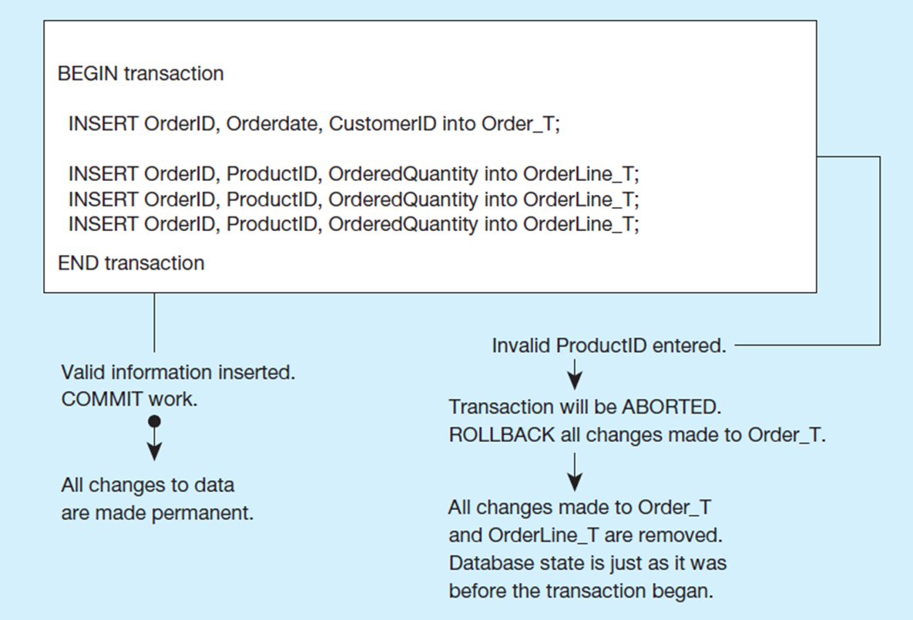
Figure 7-19 A S Q L Transaction Sequence (Pseudocode) Environment

Slide 8
Controlling Concurrent Access
Problem
In a multi-user environment, simultaneous access to data can result in interference and data loss (lost update problem)
Solution – Concurrency Control
Managing simultaneous operations against a database so that data integrity is maintained and the operations do not interfere with each other in a multi-user environment
Notes:
We’re going to see that multi-user environments add some complexity. The lost update problem is one reason. But, as we’ll see, solving the lost update problem could lead to another problem, called deadlock. We’ll explore this in the next few slides.

Slide 9
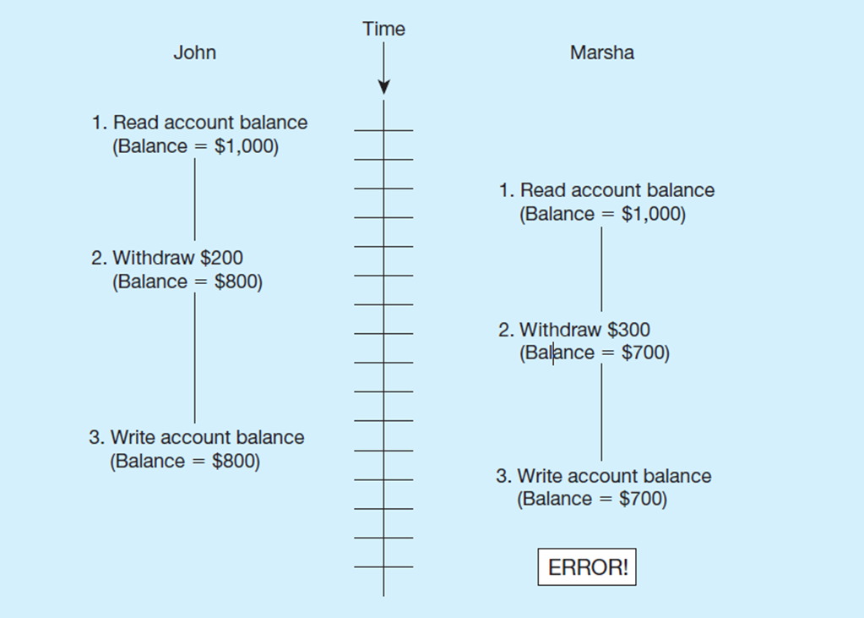
Figure 7-20 Lost Update (No Concurrency Control in Effect)
Simultaneous access causes updates to cancel each other. A similar problem is the inconsistent read problem.
Notes:
So, the idea here is that if two programs can read and write to the same record at the same time, then one may “step on the other”, thereby negating the effect of one program.
How do we prevent this? Through locking. Let’s talk about that next.

Slide 10
Concurrency Control Techniques
Serializability
Finish one transaction before starting another
Locking Mechanisms
The most common way of achieving serialization
Data that is retrieved for the purpose of updating is locked for the updater
No other user can perform update until unlocked
Notes:
The idea here is to accomplish serializability. This is usually done via locking.

Slide 11
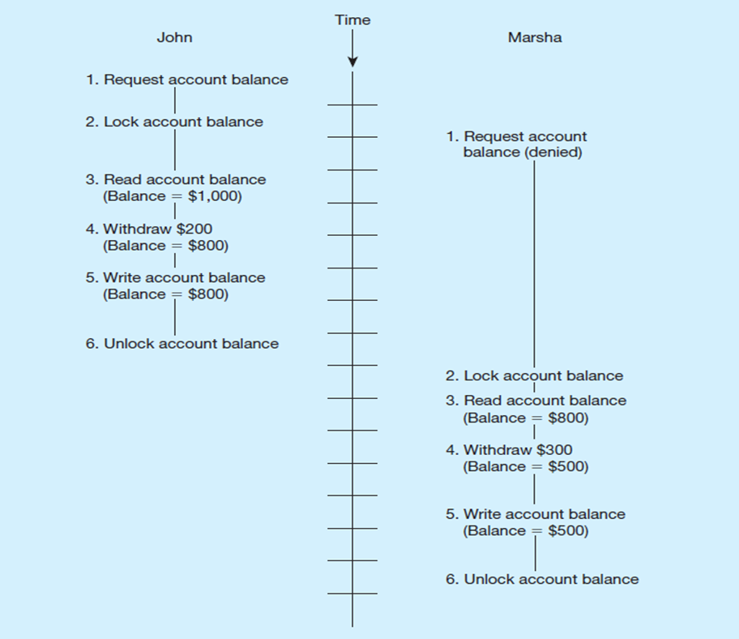
Figure 7-21 Updates with Locking (Concurrency Control)
Locking solves the lost update problem
Notes:
As you can see from this figure, locking helps to alleviate the lost update problem. You can lock at the table level or at the record level, and you can lock for updates only or updates plus queries. There are SQL commands for locking, and most DBMSs adopt a default locking (e.g., record level for updates) mechanism.

Slide 12
Locking Mechanisms
Locking level:
Database – used during database updates
Table – used for bulk updates
Block or page – very commonly used
Record – only requested row; fairly commonly used
Field – requires significant overhead; impractical
Types of locks:
Shared lock – Read but no update permitted. Used when just reading to prevent another user from placing an exclusive lock on the record
Exclusive lock – No access permitted. Used when preparing to update
Notes:
Here we see details of the types and levels of locks.

Slide 13
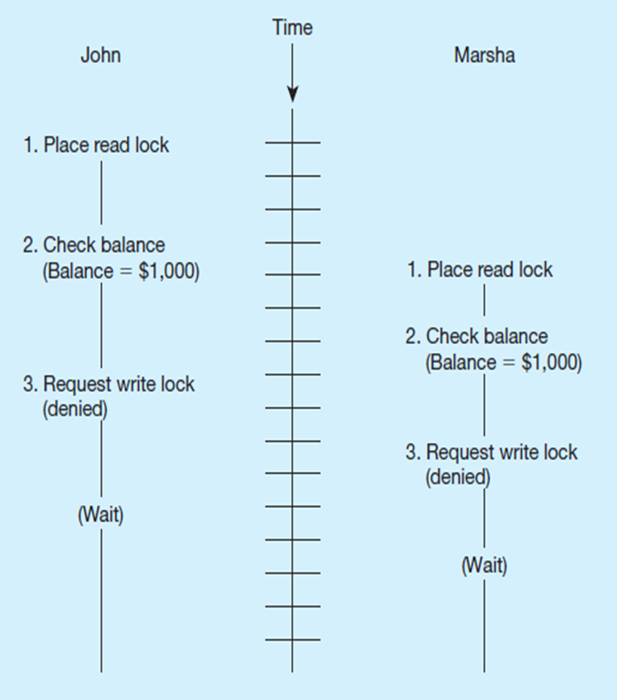
Deadlock
An impasse that results when two or more transactions have locked common resources, and each waits for the other to unlock their resources
Figure 7-22 shows the problem of deadlock
John and Marsha will wait forever for each other to release their locked resources!
Notes:
The problem with locking is that it can lead to a situation called “deadlock”. If one program has resource A locked and wants resource B, while at the same time another program has resource B locked and wants resource A, you have a deadlock. Neither can proceed until the other releases the resource it wants. So, they are both stuck.

Slide 14
Managing Deadlock
Deadlock prevention:
Lock all records required at the beginning of a transaction
Two-phase locking protocol
Growing phase
Shrinking phase
May be difficult to determine all needed resources in advance
Deadlock Resolution:
Allow deadlocks to occur
Mechanisms for detecting and breaking deadlock
Resource usage matrix
Back out one deadlock at a time
Rerun transaction
Notes:
There are two main approaches to dealing with deadlock. One is to try and prevent it from happening in the first place, and this can get pretty complicated.
A second is to just deal with it when it happens. Deadlock is not a very frequent occurrence, so if you can quickly resolve it, this is as good as preventing it in the first place.

Slide 15
Versioning
Optimistic approach to concurrency control
Instead of locking
Assumption is that simultaneous updates will be infrequent
Each transaction can attempt an update as it wishes
The system will create a new version of a record instead of replacing the old one
When a conflict occurs, accept one user’s update and inform the other user that its update needs to be tried again.
Use of rollback and commit for this
Notes:
Versioning is an alternative to locking. You won’t have deadlock, but you may require an application to redo its transaction.
The assumption here is that simultaneous updates aren’t going to happen that often. Versioning could be considered to be “optimistic” concurrency control, whereas locking is “pessimistic” concurrency control.

Slide 16
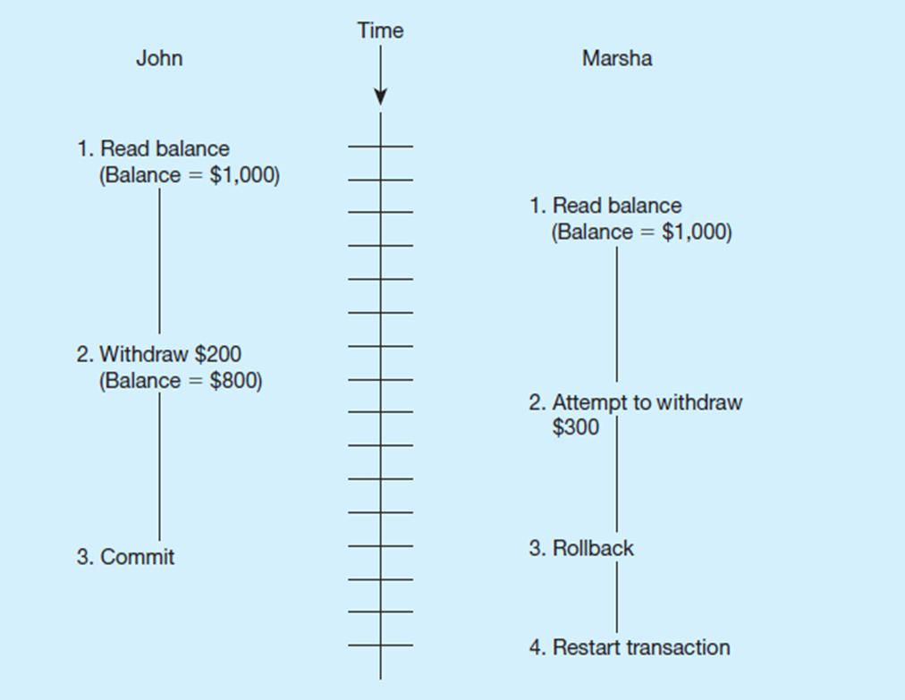
Figure 7-24 The Use of Versioning
Better performance than locking
Notes:
Here we see the result of versioning. If John’s transaction begins before Marsha’s transaction, then Marsha needs to redo hers.
Note that with versioning, you’re not going to encounter deadlock.

Slide 17
Data Security
Database Security: Protection of the data against accidental or intentional loss, destruction, or misuse
Increased difficulty due to Internet access and client/server technologies
Notes:
Data security is a critical part of any company’s IT procedures, policies, and infrastructure. This is an important task for the DA and DBA roles.
Because data are a critical resource, people in an organization must be sensitive to security threats and take measures to protect their data. Data administrators are responsible for developing overall policies and procedures to protect databases. Database administrators administer database security on a daily basis. One is more managerial and the other is more technical.

Slide 18
Threats to Data Security
Accidental losses attributable to:
Human error
Software failure
Hardware failure
Theft and fraud
Loss of privacy or confidentiality
Loss of privacy (personal data)
Loss of confidentiality (corporate data)
Loss of data integrity
Loss of availability (e.g., through sabotage)
Notes:
All of these losses can be very costly, and some can threaten the very existence of a company.

Slide 19
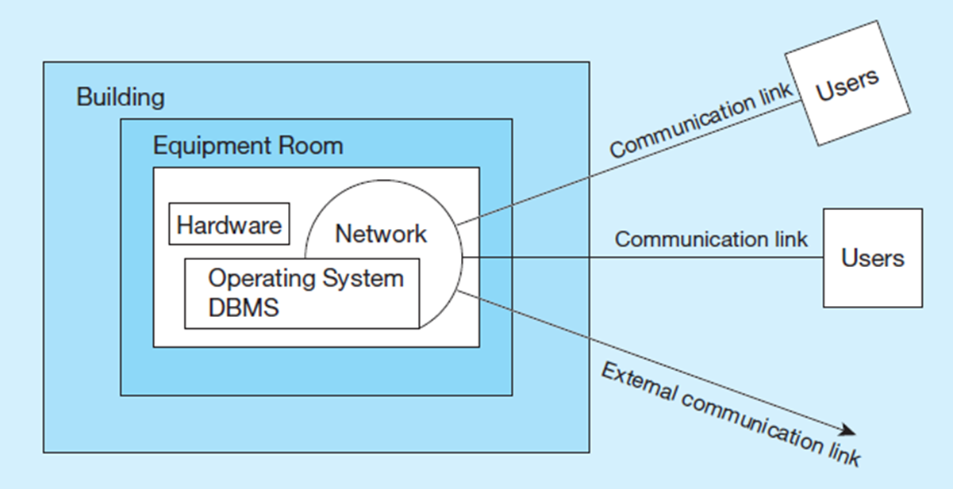
Figure 7-25 Possible Locations of Data Security Threats
Threats come from many sources and vulnerabilities exist in multiple places within an information system.
Notes:
Threats to data security may be direct threats to the database. For example, those who gain unauthorized access to a database may then browse, change, or even steal the data to which they have gained access. But threats come from other places as well, so focusing on database security alone won’t ensure a secure database. All parts of the system must be secure, including the database, the applications using the database, the network, the operating system, the building(s) that house the database, and all personnel who have access to the system.

Slide 20
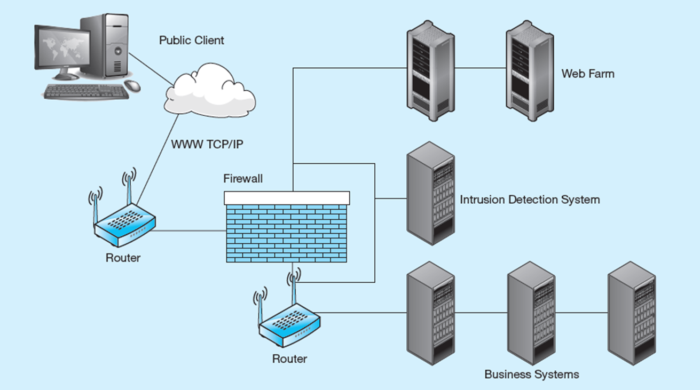
Figure 7-26 Establishing Internet Security
Notes:
For static Web pages, the security concerns are on access to the html files on the server. With dynamic Web pages though, there is also concern about database access.
The server that owns the database connection should be physically secure, and the execution of programs on the server
should be controlled. User input, which could embed SQL commands, also needs to be filtered so unauthorized scripts are not executed. In other words, the system needs to protect against SQL Injection, a particularly harmful data security threat in Web application environments.

Slide 21
Client–Server Application Security
Static H T M L files are easy to secure
Standard database access controls
Place Web files in protected directories on server
Dynamic pages are harder
User authentication
Session security
S S L for encryption
Restrict number of users and open ports
Remove unnecessary programs
Notes:
There is an interesting Web security project called OWASP, Open Web Application Security Project, at http://owasp.org. They have a great deal of useful information for security of dynamic Web application systems.

Slide 22
Data Privacy
W3C Web Privacy Standard
Platform for Privacy Protection (P3P)
Addresses the following:
Who collects data
What data is collected and for what purpose
Who is data shared with
Can users control access to their data
How are disputes resolved
Policies for retaining data
Where are policies kept and how can they be accessed
Notes:
Privacy is an increasing concern.
E-mail, e-commerce, and other online resources allow organizations (employers, governments, and businesses) to get data about people’s Internet behavior. Applications that return individualized responses require that information be collected about the individual, but at the same time proper respect for the privacy and dignity of employees, citizens, and customers should be observed. It’s a delicate balancing act.
Information privacy legislation gives individuals the right to know what data have been collected about them and to correct any errors in those data. As the amount of data exchanged continues to grow, the need is also growing to develop adequate data protection.
The W3C’s Platform for Privacy Preferences (P3P) standard communicates a Web site’s stated privacy policies and compare that statement with the user’s own policy preferences. P3P uses XML code on Web site servers that can be fetched automatically by any browser or plug-in equipped for P3P.

Slide 23

Copyright

